Slide 1
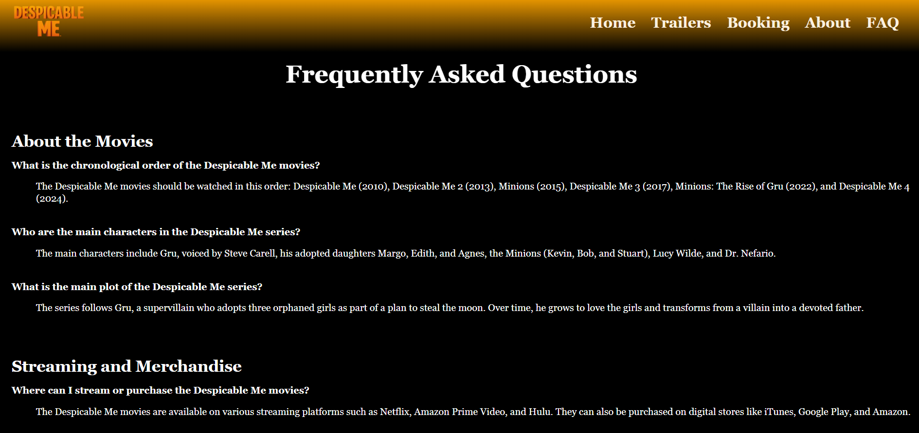
Despicable Me
Zarni Kaung Htut Kyaw
(101064447)

Slide 2
Table of Contents
01
02
03
04
Introduction
Files
Briefly about the websites
Html, CSS & Javascript
Exploration
Conclusion
Explanation of some aspects
Self-feedback

Slide 3
01
Introduction

Slide 4

Promote Despicable ME
Buy tickets

Slide 5
02
HTML, CSS & JS

Slide 6
HTML
home.html
trailers.html
booking.html
review.html
faq.html
CSS
Style.css
JavaScipt
Script.js
Others > images & a video

Slide 7
03
Explore website

Slide 8
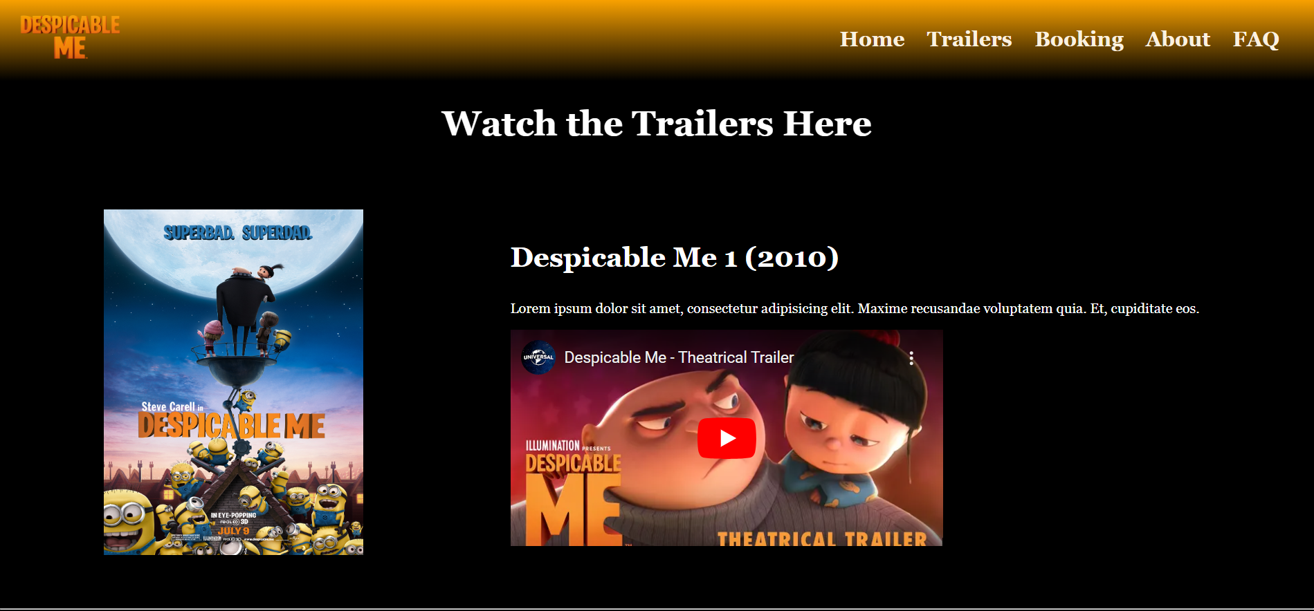
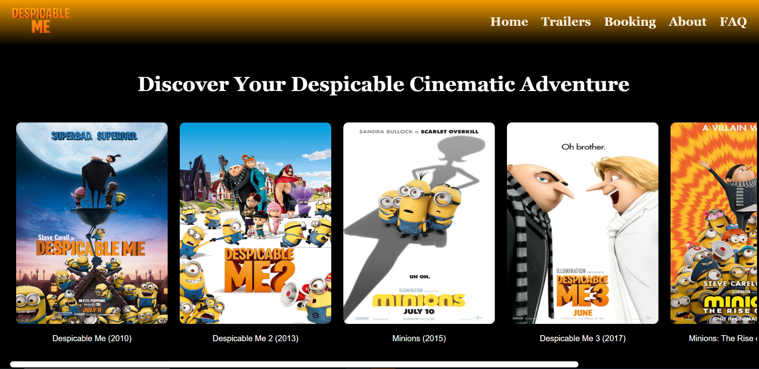
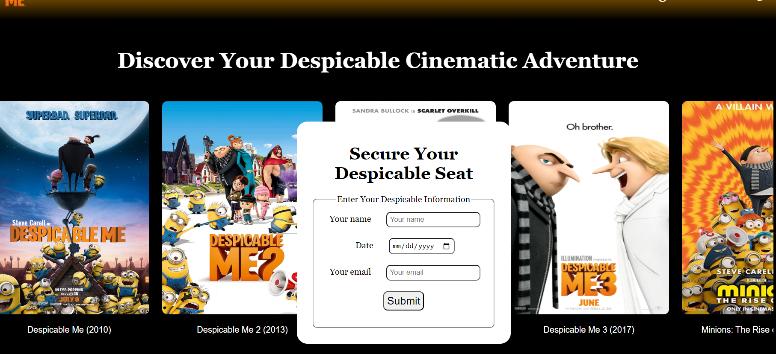

Slide 9
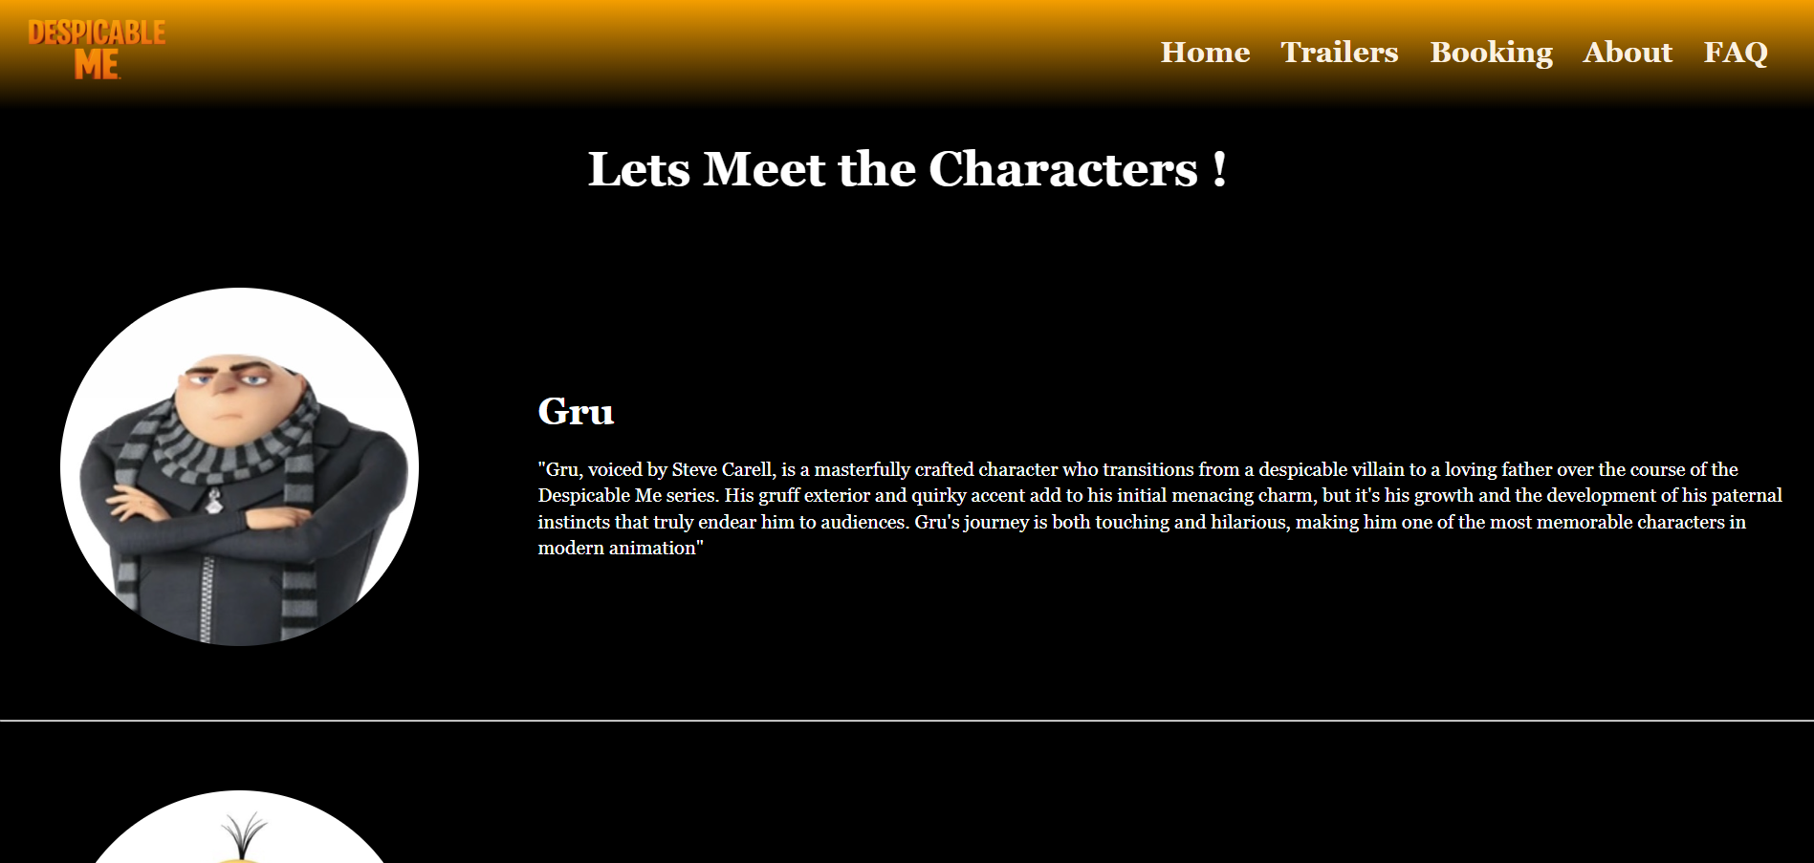

Slide 10
04
Conclusion

Slide 11
Conclusion
- It inspires Netflix webpage.
- But it is not a fully functional website.

